Slide 1

Department of BES-II
BASIC ELECTRICAL & ELCTRONIC CIRCUITS (BEC)
COURSE CODE : 23EC1203
Topic:
Ic 555 tIMER
Session – No.

Slide 2



AIM OF THE SESSION
To familiarize students with the basic concept of IC555 timers
INSTRUCTIONAL OBJECTIVES
This Session is designed to:
Demonstrate IC555 pin configuration
Describe circuit diagram
List out the modes of operation
LEARNING OUTCOMES
At the end of this session, you should be able to:
Define IC 555 with PIN configuration
Describe The operation of 555 IC TIMER
Summarize APPLICATIONS.

Slide 3
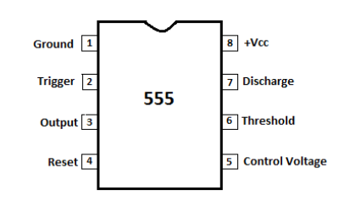
555 Time IC Pin Diagram

Slide 4
PIN DESCRIPTION IC 555
Pin no | pin description | Purpose
1 | Ground | Ground reference voltage, low level (0 V)
2 | Trigger | This output is driven to approximately 1.7 V below +Vcc, or GND
3 | output | This output is driven to approximately 1.7 V below +Vcc or GND.
4 | Reset | A timing interval may be reset by driving this input to GND, but the timing does not begin again until RESET rises above approximately 0.7 volts. Overrides TRIG which overrides threshold.
5 | Control voltage | Provides “control” access to the internal voltage divider (by default, 2/3 Vcc).
6 | Threshold | The timing (OUT high) interval ends when the voltage at the threshold is greater than that at CTRL (2/3 Vcc if CTRL is open).
7 | Discharge | Open collector output which may discharge a capacitor between intervals. In phase with output.
8 | VCC | Positive supply voltage, which is usually between 3 and 15 V depending on the variation.

Slide 5
Major features of the 555 timers
555 timer is used in almost every electronic circuit ,
A 555 timer works as a flip-flop or as a multi-vibrator, it has a particular set of configurations.
It operates from a wide range of power ranging from +5 Volts to +18 Volts supply voltage.
Sinking or sourcing 200 mA of load current.
The duty cycle of the timer is adjustable.
Maximum power dissipation per package is 600 mW,
Trigger pulse and reset inputs have logic compatibility.

Slide 6
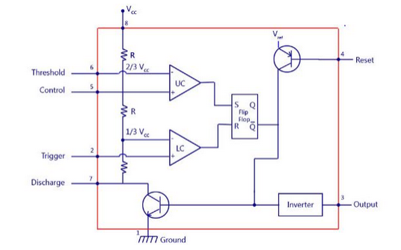
internal circuit-IC 555
INNER ARCHITECTURE

Slide 7
MODES OF OPERATION OF IC555
The NE555 timer IC generally operates in 3 modes:
1) Astable Mode 2) Monostable Mode 3) Bi-stable modes
Astable Mode
This means there will be no stable level of output. So the output will be swinging between high and low. This character of unstable output is used as a clock or square wave output for many applications.
Monostable Mode
This configuration consists of one stable and one unstable state. The stable state can be chosen as either high or low by the user. If the stable output is set at high (1), the output of the timer is high (1).
At the application of an interrupt, the timer output turns low (0). Since the low state is unstable it goes to high (1) automatically after the interrupt passes. Similar is the case for a low stable monostable mode.
Bi-stable Mode
In bistable mode, both the output states are stable. At each interrupt, the output changes from low (0) to high (1) and vice versa, and stays there. For example, if we have a high (1) output, it will go low(0) once it receives an interrupt and stays low (0) till the next interrupt changes the status.

Slide 8

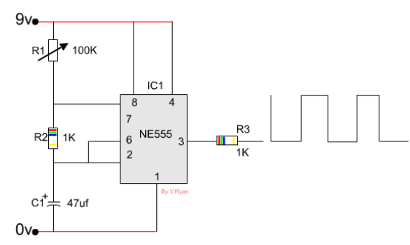
ACTIVITIES/ CASE STUDIES/ IMPORTANT FACTS RELATED TO THE SESSION
The 555 circuit shown below is very similar to the one above and it is called a ‘pulse generator’. Circuits like this are often used to produce a pulse or signal that will start a second circuit. This can be seen in a simple alarm.
A alarm consists of two circuits, one is a 555 pulse generator and the other detects the pulse. If the pulse is removed a buzzer on the second circuit sounds.
This type of circuit could be useful on a door. When the door is shut the alarm is turned on.
The first 555 circuit generates a pulse (positioned on the door frame) and the second circuit detects the pulse and is positioned on the door itself. If the door is opened the connection between the two circuits is broken. The second circuit can not detect a pulse and so the buzzer sounds.

Slide 9
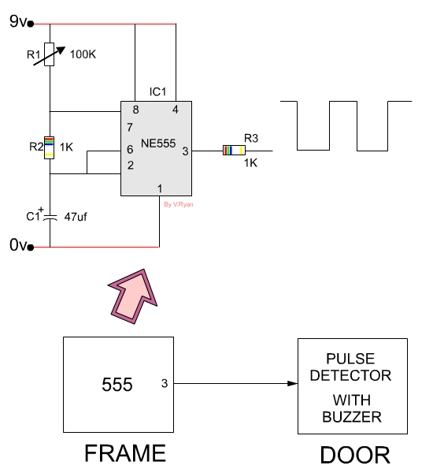
IC 555 APPLICATIONS
TIMERS
Dimmer circuits
PULSE GENERATOR CIRCUITS
ALARMING CIRCUITS
DUTY CYCLE Adjuster
SQUARE WAVE GENERATORS

Slide 10
SUMMARY
IC pin configuration ,
operating modes , Applications of 555 as Timer circuits ,
Wave form Generators are described.

Slide 11
SELF-ASSESSMENT QUESTIONS
…IC 555 can be used as
… switch
…amplifier
… timer
… vibrator
…. Howmany modes of operation does a 555 timer IC consists of?
…5
…3
…1
…2

Slide 12
TERMINAL QUESTIONS
1. Describe the pin configuration of IC 555
2. List out the applications of 555 IC
3. Mention the operating modes of 555 IC
4. Summarize the applications of TIMERS.

Slide 13
REFERENCES FOR FURTHER LEARNING OF THE SESSION
Sites and Web links:
1. https://www.electronicsforu.com/videos-slideshows/live-diy-led-dimmer-circuit-using-555-timer
2. https://www.electronicsforu.com/technology-trends/learn-electronics/555-timer-working-specifications

Slide 14
THANK YOU
Team – Fundamentals of IoT & Sensors

